Slide 1

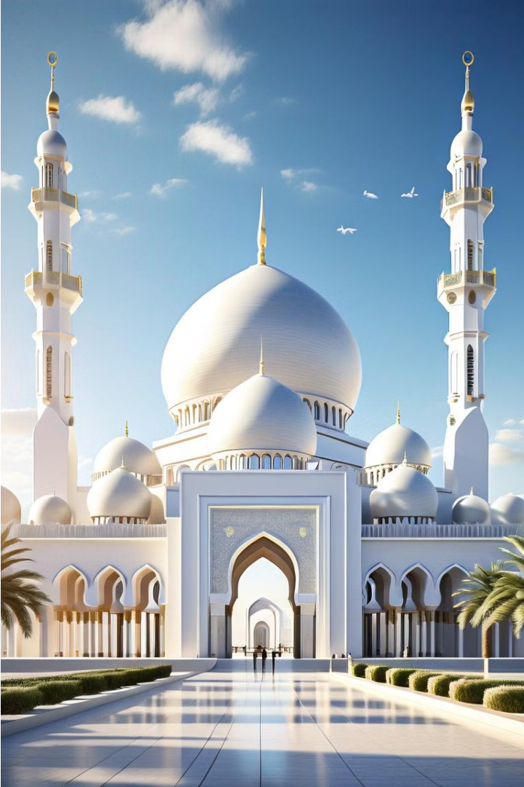
Introduction to the Political System of Islam
The political system of Islam is rooted in the teachings of the Quran and the life of the Prophet Muhammad. It emphasizes justice, equality, and the rule of law under the guidance of Islamic principles.

Slide 2

The Concept of Sovereignty in Islam
Divine Sovereignty
Rule of Law
Community Consent
In Islam, sovereignty belongs to God (Allah) alone. The political authority is derived from and accountable to the divine will as revealed in the Quran and Sunnah.
Islamic governance is based on the rule of law, where the ruler and the ruled are both subject to the same set of divine laws and principles.
While sovereignty ultimately rests with God, the Islamic political system emphasizes the role of the community (Ummah) in selecting and legitimizing leadership through the principle of Shura (consultation).

Slide 3

The Role of the Caliphate
In the Islamic political system, the Caliphate was the supreme governing authority. The Caliph, considered the successor to the Prophet Muhammad, held immense political, religious, and military power over the Muslim ummah or community.
The Caliphate served as the centralized institution that upheld Islamic law, promoted the faith, and expanded the boundaries of the Islamic world through conquest and diplomacy.

Slide 4
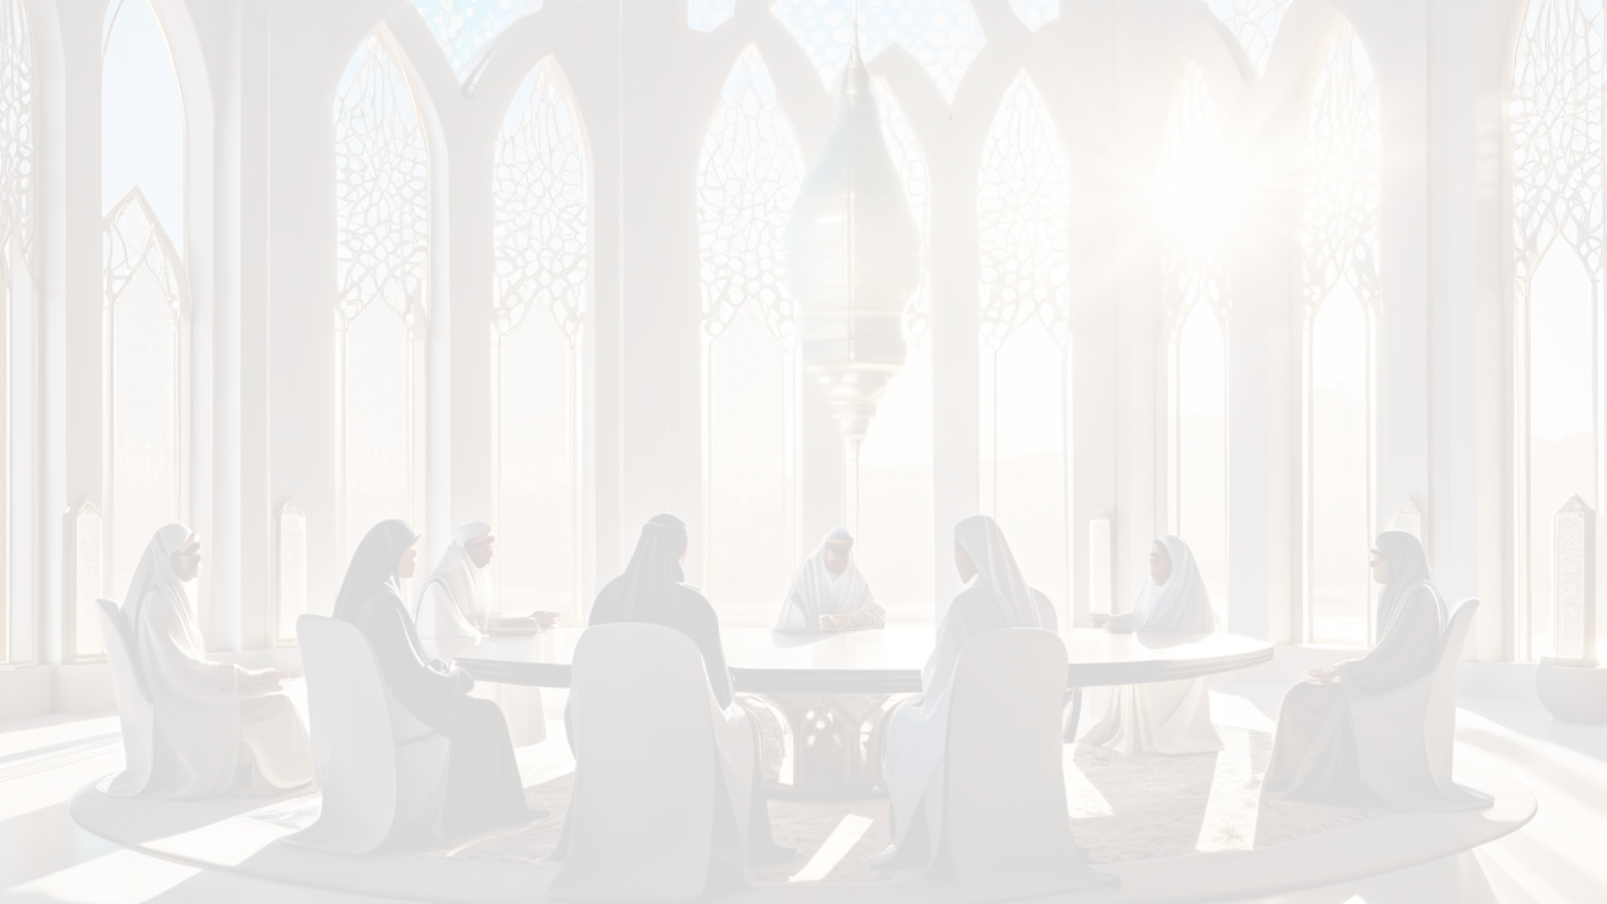
The Principle of Shura (Consultation)
Collaborative Governance
Checks on Power
Inclusive Deliberation
Shura serves as a check on the ruler's authority, ensuring that decisions are made with the input and consent of the governed. This promotes accountability and prevents tyranny.
The Shura process involves representatives from diverse backgrounds, allowing for robust debate and the consideration of multiple perspectives before reaching consensus.
In Islamic political thought, the principle of Shura emphasizes the importance of collective decision-making through consultation with the people. This fosters a participatory system of governance.

Slide 5
The Concept of Justice in Islamic Governance
Adl (Justice)
Equality Before the Law
Protection of Rights
Accountability of Rulers
Justice is a fundamental principle in Islamic governance, rooted in the Quran and Sunnah. It is seen as a divine attribute that must be upheld by those in power.
The Islamic system emphasizes that all citizens, regardless of status or background, are equal before the law. Rulers are subject to the same laws as the people they govern.
The political system in Islam is designed to protect the rights and freedoms of all citizens, including minorities. This includes the right to practice one's religion, freedom of speech, and economic rights.
Islamic governance holds rulers accountable for their actions and decisions. They are expected to rule with integrity, fairness, and in accordance with Islamic principles.

Slide 6
The Rights and Responsibilities of Citizens
1
Civil Liberties
2
Political Participation
Citizens in an Islamic state are guaranteed fundamental rights such as freedom of religion, expression, and association within the boundaries of Sharia law.
Citizens have the right to participate in the political process through the principle of Shura (consultation) and to hold leaders accountable.
3
Social Welfare
4
Duties and Obligations
The state is responsible for ensuring a basic standard of living and providing for the needy, including the poor, elderly, and disabled.
Citizens have a duty to obey the law, pay taxes, and fulfill their responsibilities to the community and the state.

Slide 7
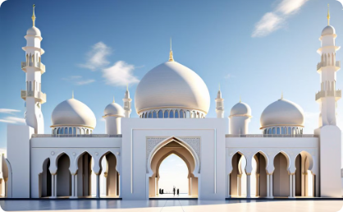
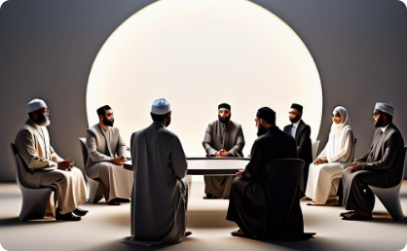
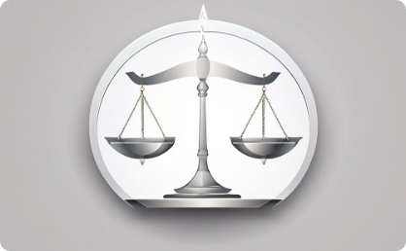
The Separation of Powers in Islamic Governance
Balanced Governance
Consultative Decision-Making
Impartial Judiciary
The Islamic political system emphasizes a balance of power between different institutions, such as the caliph, the council of advisors, and the religious scholars, to prevent the concentration of authority in a single entity.
The Islamic political model includes an independent judiciary system that operates based on the principles of fairness and justice, separate from the executive and legislative branches of government.
The principle of Shura, or consultation, ensures that important decisions are made through a process of collective deliberation and consensus, rather than unilateral authority.

Slide 8
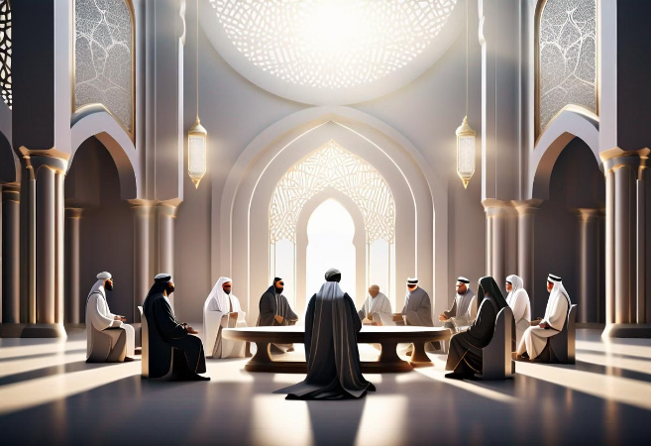
The Role of Islamic Law (Sharia) in the Political System
In the Islamic political system, Sharia law plays a central role in governance. Sharia, derived from the Quran and Sunnah, provides a comprehensive framework for regulating all aspects of society, including politics, economics, and social relations.
Sharia law is viewed as the divinely-ordained path that Muslims must follow to achieve justice, social harmony, and spiritual well-being. It serves as the foundation for Islamic legal and political institutions, guiding the actions of both the ruler and the ruled.

Slide 9
Challenges and Criticisms of the Islamic Political System
1
Interpretations of Sharia Law
2
Theocratic Tendencies
Debates around the interpretation and implementation of Islamic law (Sharia) have led to divergent views and political conflicts.
Some argue that the integration of religion and politics in the Islamic political model can lead to theocratic tendencies and limit democratic freedoms.
3
Diversity and Minority Rights
4
Adaptation to Modern Times
Concerns have been raised about the protection of minority rights and religious/ethnic diversity within the framework of an Islamic political system.
Adapting the traditional Islamic political model to the realities of the modern world has been a significant challenge for many Muslim-majority countries.

Slide 10
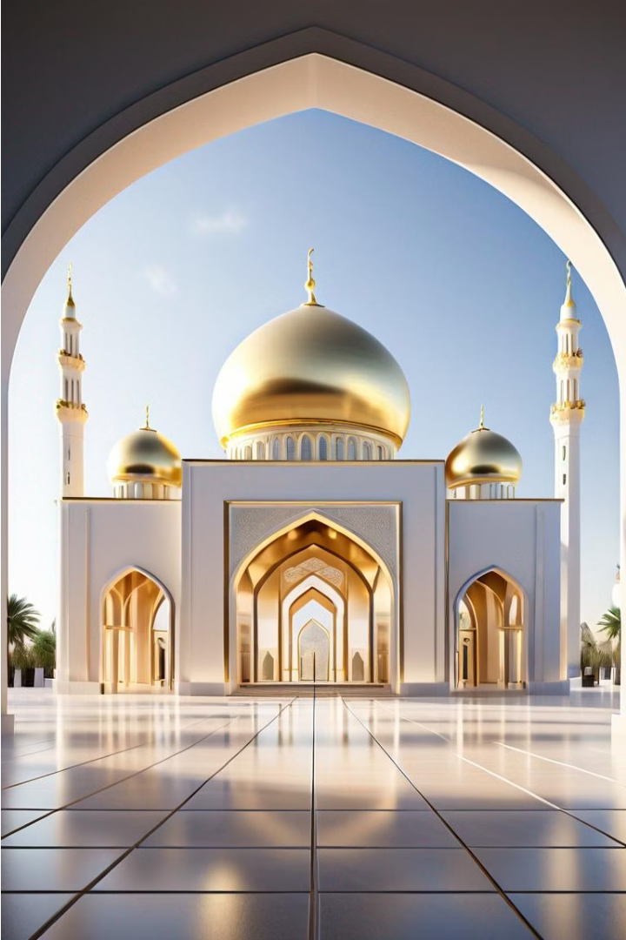
The Enduring Relevance of the Islamic Political Model
The Islamic political system, rooted in the principles of sovereignty, justice, and consultation, continues to hold profound relevance in the modern world. Its emphasis on balancing individual rights and collective responsibilities offers a model for effective and ethical governance.

